Slide 1

Zephyr RTOS Power Management (PM) Optimizing energy efficiency in embedded system

Slide 2
Zephyr RTOS Power Management (PM)
The Power Management subsystem in Zephyr enables developers to optimize energy consumption in embedded systems by leveraging SoC hardware features.
The PM subsystem in Zephyr is designed to be architecture and SoC independent — meaning it provides an abstraction so that the rest of the OS/application doesn’t need to know the specifics of each SoC’s power modes.
Core Components
System Power Management (System PM): Controls the entire system’s power state (e.g., sleep, deep sleep, suspend).
Device Power Management (Device PM): Manages power states of individual devices (drivers, peripherals).
Device Runtime PM: Dynamically manages device power states at runtime, based on usage.
Power Domains: Logical grouping of devices that share a common power source, allowing coordinated power control.
System Power Management = global states;
Device Power Management (Device PM = per-device states.
Runtime PM
Automatic suspend/resume based on usage (reference counting).
What are Power Domains
Groups of devices sharing a power source, managed together.

Slide 3
RTOS Power Management (PM) Architecture
Layer | Responsibility
Application | Requests power-saving policies or device usage.
System PM | Decides global system state (idle, sleep, deep sleep).
Device PM | Manages device-level states (active, suspended, off).
Runtime PM | Automatically suspends/resumes devices based on activity.
Power Domains | Groups devices for coordinated power transitions.
Hardware (SoC) | Provides low-power modes, wakeup sources, clock gating.
System PM: Decides when the whole system can sleep.
Device PM: Ensures individual devices are powered down when not needed.
Runtime PM: Automates device PM, so developers don’t need to manually suspend/resume every time.

Slide 4
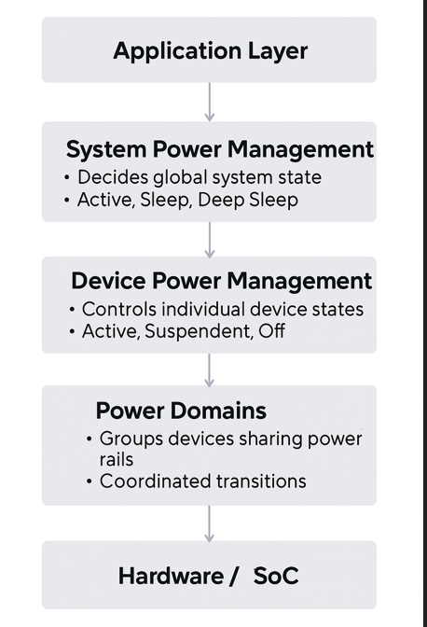
Zephyr RTOS Power Management (PM) Architecture
Application Layer
Initiates requests and interacts with the user or higher-level software.
Triggers actions that may affect system power consumption.
System Power Management (SPM)
Makes decisions about the overall system power state.
Common states include:
Active – system fully operational
Sleep – low power state with quick resume
Deep Sleep – minimal power usage, longer wake-up time
Device Power Management (DPM)
Controls the power state of individual devices within the system.
States include:
Active – device is fully on
Suspendent – device is in low-power mode, but can resume quickly
Off – device is completely powered down
Power Domains
Groups of devices that share the same power supply (power rails).
Allows coordinated transitions of multiple devices together to save power.
Hardware / SoC (System on Chip)
The actual physical components implementing the system.
Receives power management commands and executes transitions.

Slide 5
Zephyr RTOS – System Power Management
System Power Management (System PM) is the part of Zephyr’s Power Management subsystem that controls system-wide low-power states when the kernel is idle. It ensures efficient energy usage while balancing performance and wakeup latency.
System PM manages global system states (idle, sleep, deep sleep). It is architecture- and SoC-independent, achieved by separating the core PM infrastructure from SoC-specific implementations.
- The Policy Manager is the decision‑making component of System Power Management.
- Policy Manager selects power state that decides which power state to enter.
- Residency‑based policy → automatic, based on idle time vs. latency
- Application‑defined policy → developer logic via pm_policy_next_state()
Residency‑based policy = automatic, math‑driven, based on idle time vs. latency.
- Application‑defined policy = custom, rule‑driven, developer decides via pm_policy_next_state().

Slide 6
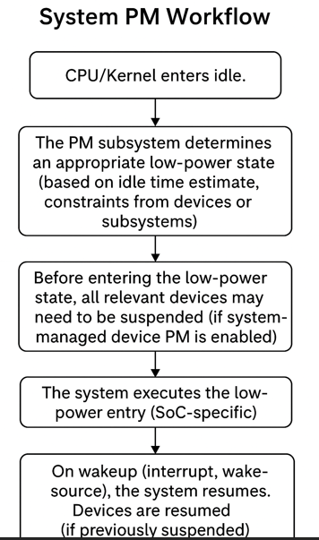
System PM (Power Management) Workflow
CPU/Kernel enters idle – The system detects no active tasks.
PM subsystem decides power state – Chooses an appropriate low-power mode based on idle time and device constraints.
Devices suspended (if needed) – Non-essential devices are powered down if system-managed PM is enabled.
System enters low-power state – Executes SoC-specific instructions to reduce power usage.
Wakeup event occurs – An interrupt or wake-source triggers system resume.
Devices and CPU resume – Suspended devices are reactivated.
Kernel returns to normal operation – Scheduler resumes regular task execution.

Slide 7
Residency‑Based Policy (Automatic)
Residency‑Based Policy (Automatic)
- Automatic decision‑making: The framework itself chooses the deepest possible low‑power state.
- It compares:
- Expected idle time (how long the system will be inactive)
- Minimum residency (the minimum time a state must be entered to be worthwhile)
- Exit latency (time needed to wake up from that state)
- If (idle_time ≥ min_residency + exit_latency), the system can safely enter that state.
Example Scenario
- System idle time predicted: 100 ms
- Deep Sleep requires: 50 ms residency + 10 ms exit latency = 60 ms
- Since 100 ≥ 60, pm_policy_next_state() selects Deep Sleep.

Slide 8
Application-defined Policy (pm_policy_next_state())
Application-defined Policy (pm_policy_next_state())
Instead of letting the system decide, the application developer writes custom logic in the function pm_policy_next_state().
This function tells the PM framework which state to enter, based on application-specific rules.
Custom Logic (Application-Defined)
Developers can override pm_policy_next_state() with their own logic.
Example:
Prevent deep sleep if BLE is connected.
Force shallow sleep if a sensor read is scheduled soon.
Allow deep sleep only during certain time windows.
- pm_policy_next_state() = the decision function for choosing the next system power state.
- By default → uses residency-based automatic logic

Slide 9
Zephyr System Power Management components
Category | Name / API / Macro | Description
Kconfig Option | CONFIG_PM | Enable system power management in Zephyr.
Power States | pm_state | Enumerated system low-power states with parameters like min_residency and exit_latency.
Constraints / Busy Status | PM_STATE_CONSTRAINTS_LIST_DEFINE(node_id, prop) | Defines constraints from device tree properties to block certain power states.
SoC/Board Backend Interface | pm_state_set() | Implements actual transition to a specified low-power state.
 | pm_system_resume() | Handles system resume after low-power state exit.
Idle Thread Integration | k_cpu_idle() | Idle thread calls system PM logic to decide and enter appropriate low-power state.
System PM APIs | pm_state_force(uint8_t cpu, const struct pm_state_info *info) | Force the system into a specific state on next idle entry.
 | pm_state_next_get(uint8_t cpu) | Retrieve the next power state for a given CPU.
Power State Macros / DT Integration | PM_STATE_DT_INIT(node_id) | Initialize pm_state from device tree.
 | PM_STATE_INFO_DT_INIT(node_id) | Initialize pm_state_info array from device tree.
Additional Utilities / Arch APIs | arch_cpu_idle() | Enter low-power idle mode.
 | arch_cpu_atomic_idle(unsigned int key) | Atomically enable interrupts and enter idle.
 | arch_system_halt(unsigned int reason) | Halt the system with optional reason code.

Slide 10
Zephyr RTOS – Device Power Management

Slide 11
Zephyr RTOS – Device Power Management
Device Power Management (Device PM) in Zephyr provides mechanisms to control the power states of individual devices (drivers, peripherals) in a coordinated way. It ensures devices are only powered when needed, saving energy while maintaining system stability
Runtime PM is dynamic and per‑device, while System‑Managed PM is tied to system‑wide sleep states.
Device Runtime PM: Automatically suspends/resumes devices based on usage (reference counting).
System-Managed Device PM: Suspends/resumes devices when the system enters/exits low-power states.
Device States (pm_device_state): ACTIVE, SUSPENDING, SUSPENDED, OFF.
Device Actions (pm_device_action): SUSPEND, RESUME, TURN_OFF, TURN_ON.
Busy Status Indication: Mechanism to prevent suspending a device during critical operations.
Wakeup Capability: Some devices can wake the system from sleep (e.g., GPIO, RTC).

Slide 12
APIs:
pm_device_action_cb_t() – driver callback for suspend/resume actions.
pm_device_busy_set()/clear() – mark device as busy or idle.
pm_device_wakeup_enable() – enable device as wakeup source.
Macros:
PM_DEVICE_DEFINE, PM_DEVICE_DT_DEFINE – define PM resources for drivers.
PM_DEVICE_GET – retrieve PM context.
Config Options:
CONFIG_PM_DEVICE – enable device PM.
CONFIG_PM_DEVICE_SYSTEM_MANAGED – enable system-managed PM.
CONFIG_PM_POLICY_DEVICE_CONSTRAINTS – allow devices to declare constraints.
device states in Zephyr :
ACTIVE, SUSPENDING, SUSPENDED, OFF.
Application requests a device (e.g., UART).
Driver resumes the device if suspended.
Framework updates reference counts and ensures dependencies are active.
When idle, Runtime PM suspends unused devices automatically.
If the System PM enters deep sleep, all devices are suspended in order.
Hardware executes the low-power transition until a wakeup event occurs.

Slide 13
Device Power Management State Transitions in Zephyr
ACTIVE :: Device is fully powered and operational. Interrupts, bus communication, and enable pins are active.
SUSPENDED :: Device is temporarily disabled to save power. Interrupts are disabled, enable pin is low, but device can be resumed quickly.
OFF :: Device is completely powered down. Enable pin is disconnected or input to avoid back-powering. Requires reinitialization to use again.
ON :: Device is powered but not yet resumed. Typically configured into a safe/reset state before moving to ACTIVE.
Transitions
ACTIVE → SUSPENDED: Triggered by pm_device_action(SUSPEND). Saves power while keeping context.
SUSPENDED → ACTIVE: Triggered by pm_device_action(RESUME). Restores device functionality.
SUSPENDED → OFF: Triggered by pm_device_action(TURN_OFF). Fully powers down device.
OFF → ON: Triggered by pm_device_action(TURN_ON). Prepares device for use.
ON → ACTIVE: After initialization/configuration, device becomes fully operational.

Slide 14
Zephyr RTOS’s Device Runtime Power Management

Slide 15
Zephyr RTOS’s Device Runtime Power Management
Device Runtime Power Management (Device Runtime PM): A method in Zephyr’s PM infrastructure where individual devices (peripherals, drivers) can be suspended or resumed independently of whether the CPU/system is in idle or active state — i.e., while the system remains active the device can still be powered down when not in use.
Usage count / reference counting: In runtime PM, each device has a usage count;
pm_device_runtime_get(dev) — increment usage count and possibly resume device.
pm_device_runtime_put(dev) — decrement usage count and possibly suspend device when zero.
Advantages
Fine-granular power savings: Devices can be individually suspended even while the system remains active, enabling power savings beyond system idle.
Improved system sleep transitions: With devices already suspended, system PM can enter deeper sleep faster and with lower latency.
Driver/subsystem independence: The reference counting model allows drivers, subsystems, and applications to interact with device PM without tightly coupling logic across layers. Drivers don’t need to know about higher-level app usage; they just expose suspend/resume mechanics.

Slide 16
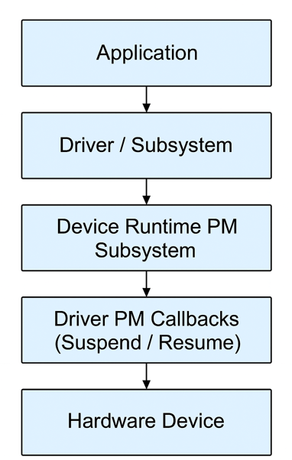
Device Power Management architecture flow
1️⃣ Application Layer
The topmost layer in Zephyr’s power management hierarchy.
May explicitly enable/disable device power states or let runtime PM handle it automatically.
2️⃣ Driver / Subsystem Layer
Drivers implement the functional interface to hardware devices.
Subsystems (like networking, sensors, or storage) may coordinate multiple drivers.
Each driver interacts with the Device PM subsystem through standard APIs (e.g., pm_device_state_set()).
3️⃣ Device Runtime PM Subsystem
Automatically suspends devices when idle and resumes them when accessed.
Maintains internal reference counts (pm_device_runtime_get()/put()).
4️⃣ Driver PM Callbacks (Suspend / Resume)
Each driver provides power management hooks:
pm_action_suspend() → Called to power down the device.
pm_action_resume() → Called to restore device functionality.
These callbacks are invoked by the PM subsystem during transitions.
Allow drivers to save/restore context, clock states, or peripheral configurations.
5️⃣ Hardware Device
The actual physical hardware (e.g., sensor, UART, SPI controller, etc.).
Power state changes occur here (active → idle → suspended → off).
Behavior depends on SoC capabilities and low-power mode implementation.

Slide 17
Zephyr RTOS – Device Runtime Power Management
Main API Functions
Key Devicetree Bindings | Description
zephyr,pm-device-disabled | Disables PM for specific power states of a device.
zephyr,pm-device-runtime-auto | Enables automatic runtime PM for a device.
zephyr,power-state | Defines CPU/SoC power states with latency and residency parameters.
CONFIG_PM_DEVICE | Enable the Device PM subsystem.
CONFIG_PM_DEVICE_RUNTIME | Enable runtime PM for devices.
CONFIG_PM_DEVICE_SYSTEM_MANAGED | Enable system-managed PM for devices.
CONFIG_PM_DEVICE_DEBUG | Enable debug tracing and logging for device PM.
CONFIG_PM_DEVICE_BROADCAST | Notify dependent devices of PM transitions.
pm_device_state_set() | Set the device’s power state.
pm_device_state_get() | Get the current device power state.
pm_device_runtime_get() | Increment runtime PM usage counter (prevent suspend).
pm_device_runtime_put() | Decrement runtime PM usage counter (allow suspend).
pm_device_runtime_enable() | Enable runtime PM for a device.
pm_device_runtime_disable() | Disable runtime PM for a device.
device_busy_set() | Mark a device as busy to prevent suspend.
device_busy_clear() | Clear busy status to allow suspend.
pm_device_wakeup_enable() | Enable device as a wakeup source.
pm_device_wakeup_disable() | Disable device as a wakeup source.
PM_DEVICE_DEFINE() | Register a device PM context manually.
PM_DEVICE_DT_DEFINE() | Register a device PM context from Device Tree node.

Slide 18
Zephyr RTOS – Power Domains

Slide 19
Zephyr RTOS – Power Domains
A Power Domain in Zephyr is a logical grouping of devices that share a common power source. Instead of managing each device individually, the system can control the entire domain, turning multiple devices on/off together. This reduces leakage currents and improves energy efficiency.
A group of devices sharing a common power source, managed together for energy efficiency.
Internal domains are SoC regions grouped for power gating; external domains are powered by regulators, switches, or PMICs outside the SoC.
Instead of managing each device individually, the system can control the entire group together.
This is especially useful when multiple peripherals depend on the same supply.
Core Components
Power Domain: A group of devices powered by the same source (internal SoC region or external regulator).
Internal Power Domain: A region inside the SoC grouping devices that can be powered down together.
External Power Domain: Devices outside the SoC powered by external regulators, switches, or PMICs.
PM Device Action: Notifications sent to devices when their domain changes state (TURN_ON, TURN_OFF, SUSPEND, RESUME).
Wakeup Source: A device in a domain that can wake the system from low-power mode.

Slide 20
Key Components Power Domains
Option | Description
CONFIG_PM_DEVICE_POWER_DOMAIN | Enable power domain support in Zephyr.
CONFIG_PM_DEVICE | Enable general device PM support (required for power domains).
CONFIG_PM_DEVICE_DEBUG | Enable debug logging for PM devices.
Devicetree Bindings
Binding | Description
compatible = "power-domain" | Declares a node as a power domain.
power-domains = <&domain_node> | Assigns a device to a power domain.
wakeup-source | Marks the domain/device as a wake source if required.
API | Purpose
pm_device_children_action_run(dev, action, NULL) | Notify all child devices of a domain about a PM action.
pm_device_get(dev) | Increment usage count and ensure device/domain is powered.
pm_device_put(dev) | Decrement usage count; suspend device/domain if count reaches 0.
pm_device_runtime_enable(dev) | Enable runtime PM for device.
pm_device_runtime_disable(dev) | Disable runtime PM.

Slide 21
Power Domains Work Flow
Workflow
1) Definition in Devicetree
- A power domain is declared as a node (e.g., regulator, PMIC, or SoC block).
Devices reference it using the power-domains property.
2) Domain ON/OFF
- When the domain is ON, all devices inside it are powered and can operate.
When the domain is OFF, all devices inside it lose power and must be suspended.
3) Device Notification
- The PM framework notifies devices in the domain when the domain changes state.
Drivers implement callbacks to handle TURN_ON and TURN_OFF actions.
4) Wakeup Sources
- Some devices in a domain may act as wakeup sources (e.g., GPIO, RTC).
- Applications or drivers must configure them before the domain is powered down.
Workflow Example
Step 1: Application decides Wi‑Fi + Bluetooth radios are idle.
Step 2: PM framework powers down the radio domain (shared regulator).
Step 3: Both Wi‑Fi and Bluetooth drivers are notified → they suspend.
Step 4: Later, when Wi‑Fi is needed, the domain is powered ON again → both radios resume.

Slide 22
Comparison of System PM vs Device PM vs Power Domains
Aspect | System PM | Device PM | Power Domains
Scope | Entire system (CPU + SoC) | Individual devices (drivers, peripherals) | Group of devices sharing a power source
Control | Kernel idle thread + policy manager | Device drivers + PM framework | Domain controller (internal SoC region or external regulator)
When Applied | During idle/system-wide low-power states | When devices are unused or system suspends | When powering ON/OFF a shared rail or regulator
Granularity | Coarse (whole system) | Medium (per device) | Group-level (multiple devices together)
States Managed | Idle, Sleep, Deep Sleep, Suspend | ACTIVE, SUSPENDING, SUSPENDED, OFF | TURN_ON, TURN_OFF (domain-level)
Wakeup Sources | RTC, GPIO, timers | Device-specific (e.g., UART, sensor) | Domain-level devices (e.g., GPIO bank, radio)
Advantages | Maximizes global energy savings | Fine-grained control, runtime automation | Reduces leakage current, simplifies group control
Limitations | Risk of latency if too deep a state | Requires careful driver implementation | Dependencies and wakeup sources must be managed
Use Case Example | MCU sleeps until timer interrupt | Suspend UART when idle | Power down all sensors on shared regulator

